Slide 1

Building and Mining Knowledge graphs
(KEN4256)
Lecture 2: KG Construction from Structured Data

Slide 2
© 2024 by Michel Dumontier and the Institute of Data Science at Maastricht University is licensed under Attribution 4.0 International
To view a copy of this license, visit http://creativecommons.org/licenses/by/4.0/
This license requires that reusers give credit to the creator. It allows reusers to distribute, remix, adapt, and build upon the material in any medium or format, even for commercial purposes.
id: KEN4256_L2
version: 1.2024.0
created: February 19, 2020
last modified: March 26, 2024
published on: March 26, 2024

Slide 3
Long history of Knowledge Representation (KR)
Existential Graphs (1896; Peirce)
Semantic Networks “semnets” (Introduced mid-1960s, hype 1980s),
Conceptual Graphs
Cognitive Semantic Networks
Structured Inheritance Networks
Multilayered Extended Semantic Networks (MultiNets)
Basic Conceptual Graphs
Full Conceptual Graphs
Hierarchical Semantic Form
Resource Description Framework (RDF)
Property Graph
Notes:
But the representation we are interested in appeared with the web, and is built on it. Which makes sense when you want to share knowledge.
Because we are going to tell a story of sharing knowledge, not only mining it
What is the web?

Slide 4
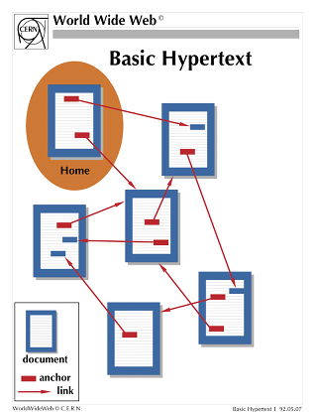

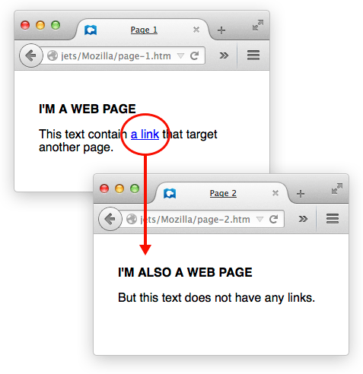


World Wide Web
information sharing
Humans have to make sense of (extract knowledge from) the information content
Notes:
The web is just a collection of HTML files accessible at specific URLs with reference to other URLs in it

Slide 5
Web 2.0 vs Web 3.0

Slide 6
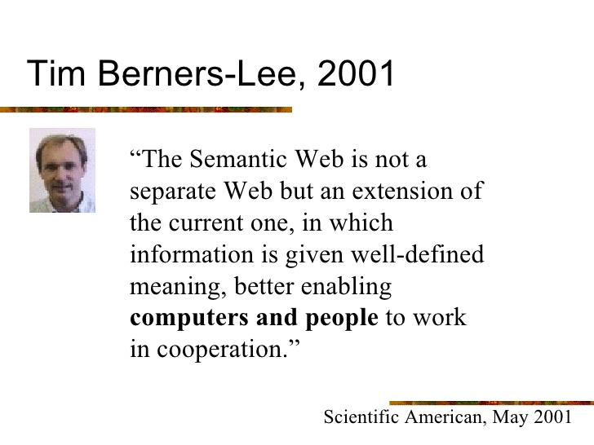
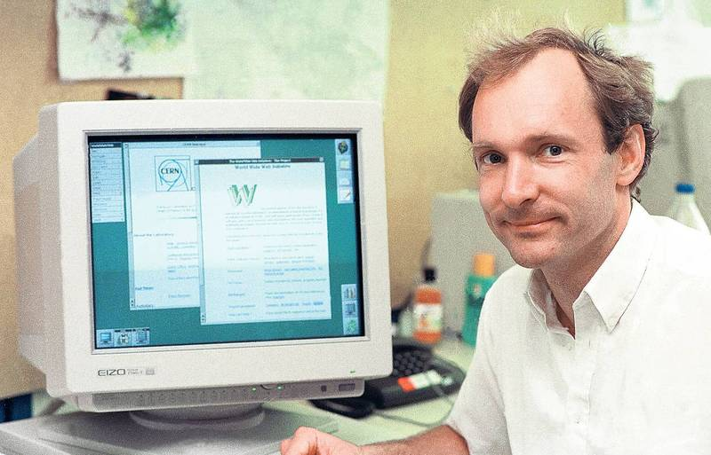
Semantic Web, the real Web 3.0
The Web 2.0 has been built to be Human readable, not machine readable.
information sharing
Humans & computers alike can interpret the information and share a common understanding of its meaning
Notes:
HTML is made to be human readable, but not especially Machine readable
The semantic web is an extension to make the HTML more machine readable, by sharing data instead of HTML
Our ultimate goal is to be the Architect from Matrix

Slide 7

World Wide Web Consortium (W3C)
Working Group for developing and maintaining Web Standards
Graphical interface standards (HTML, CSS): to make websites beautiful to human eyes.
New data formats (XML, N-Triples, N-Quads, Turtle, TriG, JSON-LD): To store and exchange data in a well defined manner.
Formal languages (RDF, RDFS, OWL) with mathematically defined symbols to represent and reason about knowledge
New query languages (SPARQL, R2RML, RML) to query and transform data
Ontologies and vocabularies (SKOS, FOAF, DCAT, PROV) to structure knowledge in a consistent manner.
Reasoning algorithms to automatically infer implicit facts about data with background knowledge
All of these new standards should be compatible with / build on top of existing Web standards
Notes:
HTML is not a language.
Ironically the most used data exchange format, JSON, has not been defined by the W3C, instead it has been extracted from JavaScript, which was written in 15 days

Slide 8
Resource Description Framework (RDF)
RDF is a framework to represent information on the Web
RDF was developed by the W3C and first became a W3C recommendation in 1999. This was superseded by the RDF 1.0 specification in 2004, and the RDF 1.1 specification in 2014. The full RDF 1.1 specification consists of:
An abstract data model with a set of implementing syntaxes (aka. formats) for storing and exchanging information represented in RDF
a formal semantics that can be extended to create vocabularies and ontologies
A first vocabulary RDF Schema which extends RDF with basic concepts and a hierarchical class system (label, subclass, subproperty…).
A query language for RDF data - SPARQL
Notes:
There is no such thing as a classless society, sorry Karl.

Slide 9

RDF is highly versatile
RDF can be used to describe things in a machine readable manner. This can include digital objects such as documents, real world objects such as people, and concepts such as Person or Organization.
RDF is a graph formalism in that the intention is to describe information about interconnected entities that can be depicted in a directed graph.
Not only used for KGs! RSS feed comes from RDF Site Summary
Notes:
An example of popular use of RDF outside of the semantic web bubble: RSS feed for keeping up to date with new content in a website (RDF Site Summary or Really Simple Syndication)

Slide 10
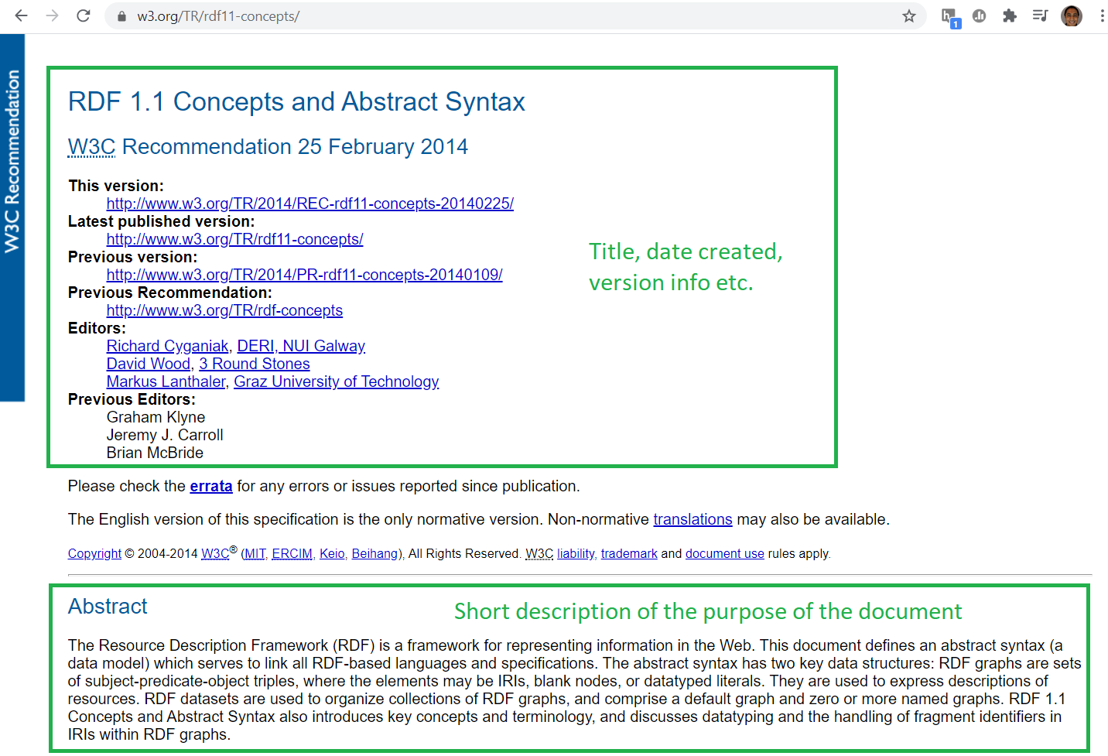
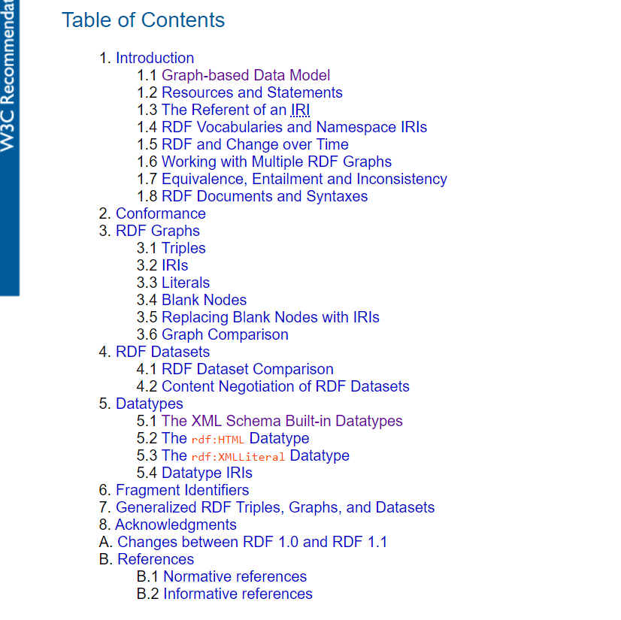
RDF spec (and a word on W3C specs in general)
Notes:
All W3C specifications are all built pretty much the same way, it might look a bit verbose at the first glance. But they are the reference, and usually not that hard to navigate and make sense of when using the Table of Contents (or ctrl+F)
I can guarantee you we will not blame you if you are getting informations from the web…

Slide 11
The RDF Data Model
The fundamental unit of an RDF graph is a statement called a triple. An RDF graph G = (S, P, O) is a set of triples comprised of a subject, predicate, and object tuple. The subject and object represent nodes in the RDF graph and the predicate represents an edge between these nodes.
predicate
subject
object
lives in
Tim
Maastricht
The subject and predicate must be an Internationalized Resource Identifier (IRI), while the object can be an IRI, blank node, or unicode string literal.

Slide 12

IRI or URI as identifiers for things
Uniform Resource Identifier: “string of characters that unambiguously (uniquely) identifies a particular resource…”
“... a name given to describe a thing. This thing can be anything in the world (either physical or abstract).”
http://dbpedia.org/page/Tim_Berners-Lee
Refers to
https://www.wikidata.org/wiki/Q80
Refers to
Things (also called resources or entities) can have multiple URIs

Slide 13
IRIs, URIs, URLs, URNs
Identifiers in this family:
Internationalized Resource Identifier (IRI): An IRI is a sequence of characters from the Universal Character Set (Unicode/ISO10646)
Uniform Resource Identifier (URI): Uses US-ASCII, a subset of ASCII, about 60 characters
Uniform Resource Locator (URL): A compact string representation of the location for a resource that is available via the Internet.
Uniform Resource Name (URN) Uniform Resource Name - a globally unique and persistent URI (even after a resource ceases to exist this identifier will remain). Protocol of URN is always “urn:” - rare in practice, used for examples
Further reading on differences: link
Using Linked Data best practices: URI = URL
URI best practices reading: CoolURIs and here
IRIs
URIs
URNs
URLs

Slide 14

Composition of an IRI
Namespace
https://springer.com/gp/book/9783030123741
scheme / protocol
domain name
resource name
This URI has a “Slash” namespace (last character preceding the resource name is a “/” character).
Can also have “Hash” namespaces in URIs e.g. http://www.w3.org/1999/02/22-rdf-syntax-ns#type
Notes:
Note that the people who started RDF used the worst URI possible: useless www prefix, full date, barely coherent mix of - and /
Don’t be like Tim!

Slide 15
Prefixed name
A prefixed name is a prefix label and a local part, separated by a colon ":". A prefixed name is turned into an IRI by concatenating the IRI associated with the prefix and the local part.
springer:9883030123741
is equivalent to: https://springer.com/gp/book/9783030123741
when the prefix is declared in a RDF document,
PREFIX springer: <https://springer.com/gp/book/>

Slide 16


What is the namespace of the following resource: http://publications.europa.eu/ontology/cdm#ATTO_FD_010 ?
ⓘ
Click Present with Slido or install our Chrome extension to activate this poll while presenting.
Notes:
📣 This is Slido interaction slide, please don't delete it. ✅ Click on 'Present with Slido' and the poll will launch automatically when you get to this slide.

Slide 17
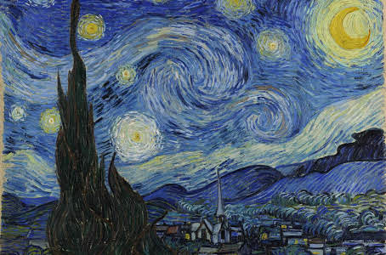
RDF Subjects, Predicates, Objects
Subjects and Predicates (aka. properties) are denoted by IRIs
Objects are either:
an IRI (we talk about object property)
or a literal value (data property)
Starry night (June 30, 1889) by Vincent van Gogh
Object property
Subject
Predicate
Object - IRI
<http://somenamespace.com/starrynight> <http://somenamespace.com/createdBy> <http://somenamespace.com/Vincent_van_Gogh> .
Object - Literal
Data property
<http://somenamespace.com/starrynight> <http://somenamespace.com/dateCreated> “1889-06-30”^^xsd:date .
N-Triple format: IRIs are encapsulated with < >, literals are encapsulated “ ”, and ends with period .
Notes:
...and this is where the connection with Linked Data comes in!

Slide 18
RDF Literals
A literal can be accompanied by additional, and optional, details:
a datatype IRI, that determines how the lexical form maps to a literal value.
a language tag only when the datatype IRI is a rdf:langString
Many RDF syntaxes use ^^ (double caret) to associate the datatype of a literal with is lexical form, and the @ (at sign) for specifying the language tag:
“1.01”^^<https://www.w3.org/2001/XMLSchema#decimal>
“1.01”^^xsd:decimal
“Maastricht University”@en
“Universiteit Maastricht”@nl

Slide 19
Data types of literals
The use of XML Schema data types is recommended (they are predefined and widely used)
Strings: "Maastricht University"
Integers: "1"ˆˆ<http://www.w3.org/2001/XMLSchema#integer>
Integers: "1"ˆˆxsd:integer
Decimals: "1.23"ˆˆxsd:decimal
Date: "2014-9-11"ˆˆxsd:date
Time: "11:05:45"ˆˆxsd:time
Date with time: "2014-9-11T11:05:45"ˆˆxsd:dateTime

Slide 20
RDF Blank Nodes
There are three kinds of object nodes in an RDF graph: IRIs, literals, and blank nodes.
Blank nodes are nodes that do not have a persistent identifier, and therefore cannot be reliably linked to by others. They are convenient for prototyping or complex data structure where there is no desire to assign a permanent identifier. They are used in some RDF syntaxes and some RDF store implementations.
⚠️ It is not recommended to use blank nodes. Instead assign IRIs. We expect your work to not use blank nodes.

Slide 21
IRIs can be abbreviated using defined prefixes
Full IRI:
http://www.w3.org/1999/02/22-rdf-syntax-ns#type
Define an abbreviation for your namespace (called a prefix):
@prefix rdf: <http://www.w3.org/1999/02/22-rdf-syntax-ns#>
Shortened IRI: rdf:type
ℹ️ Use https://prefix.cc to find out the URI associated to a prefix

Slide 22
RDF Predicates (built-in)
RDF has some predicates built into its vocabulary that the specification developers decided would be needed and widely reused, independent of the type of information captured.
ℹ️ http://www.w3.org/1999/02/22-rdf-syntax-ns#type aka. rdf:type or just “a”, is a special predicate defined by RDF which is used to specify a category (called a concept, class or type) to which an entity belongs (the “is a” relation). The category / type entities are usually defined in an ontology / vocabulary (e.g. schema.org). Entities which belong to a certain type are called instances of that type.
🏷️ http://www.w3.org/2000/01/rdf-schema#label aka. rdfs:label, is a predicate defined by the RDF Shema vocabulary which can be used to attach a string label or name to an entity in the graph.
<http://somenamespace.com/starrynight> <http://www.w3.org/2000/01/rdf-schema#label> “The Starry Night”@en .
<http://somenamespace.com/starrynight> <http://www.w3.org/1999/02/22-rdf-syntax-ns#type> <http://somenamespace.com/Painting> .
Instance
“Starry night is an instance of the Painting class”
Class
Notes:
Xu might add one rdf:type slido

Slide 23
RDF Schema
RDF Schema is a vocabulary to enhance the meaning of RDF entities with human readable annotations and machine-understandable semantics
RDF Schema defines a vocabulary for:
labels, descriptions, and pointers to other resources
classes and class hierarchies
properties and property hierarchies
the domains and ranges of properties
RDF Schema Doc: https://www.w3.org/TR/rdf-schema/
RDFS: http://www.w3.org/2000/01/rdf-schema#

Slide 24
RDF(S) Annotation Properties
Properties that improve human readability
rdfs:label, to associate a human friendly label (name) with the resource. Range: Literal
rdfs:comment, to add additional information about the resource. Range: Literal
rdf:value, to add a structured value for the resource. Range: Literal
Properties that enables us to refer other RDF definitions
rdfs:seeAlso, to point to another resource that provides additional information about the resource. Range: IRI
rdf:isDefinedBy, to specify the resource that is responsible for its definition (e.g. an ontology or vocabulary). Range: IRI

Slide 25
RDFS Classes
RDF Schema contains the following classes:
rdfs:Resource, the class of all resources
rdfs:Class, the class of all classes
rdf:Property, the class of all Properties
rdf:langString, the class of language-tagged string values
rdfs:Literal, the class of all literals (strings)
rdfs:Datatype, the class of datatypes
rdf:Statement, the class of all reified statements (using the predicates rdf:subject, rdf:predicate and rdf:object)

Slide 26
RDFS Inference
RDF Schema offers basic inference with those properties:
rdfs:subClassOf
rdfs:subPropertyOf
rdfs:domain
rdfs:range

Slide 27
RDFS Inference
RDF Schema offers basic inference with those properties:
rdfs:subClassOf
rdfs:subPropertyOf
rdfs:domain
rdfs:range
ex:Bob foaf:knows ex:Alice
foaf:knows rdfs:domain foaf:Person .

Slide 28
RDFS Inference
RDF Schema offers basic inference with those properties:
rdfs:subClassOf
rdfs:subPropertyOf
rdfs:domain
rdfs:range
ex:Bob foaf:knows ex:Alice .
foaf:knows rdfs:domain foaf:Person .
->
ex:Bob rdf:type foaf:Person .

Slide 29
RDFS Inference
From
ex:Bob rdf:type ex:Human .
ex:Human rdfs:subClassOf ex:Mammal .
🧠 We can infer that Bob is a Mammal!
ex:Bob rdf:type ex:Mammal .
⚠️ RDFS and ontologies are not built to constraint data! Only to infer new statements.
✅ So, we can infer that Bob is a Mammal
❌ But you can’t make complicated inferences: An individual is either a bird or a person. all birds have feathers, Bob has no feathers, therefore Bob is not a Bird.
🌍️ This kind of knowledge can be inferred with more sophisticated KR languages such as the Web Ontology Language

Slide 30
RDF Predicates and Classes (external)
There are other predicates, and classes, outside of RDF defined in other vocabularies on the Web. There are many of these vocabularies, anyone can define and publish one.
Some domain-specific e.g. biomedicine, and some domain-agnostic.
🔍️ You can search for predicates and classes in the Linked Open Vocabularies service: https://lov.linkeddata.es/dataset/lov
E.g. the IRI https://schema.org/employees is a predicate defined by the popular Schema.org vocabulary, defined by a collaboration among the world’s major search engines.
<http://somenamespace.com/maastricht_university> <https://schema.org/employees> <http://somenamespace.com/Xu> .

Slide 31
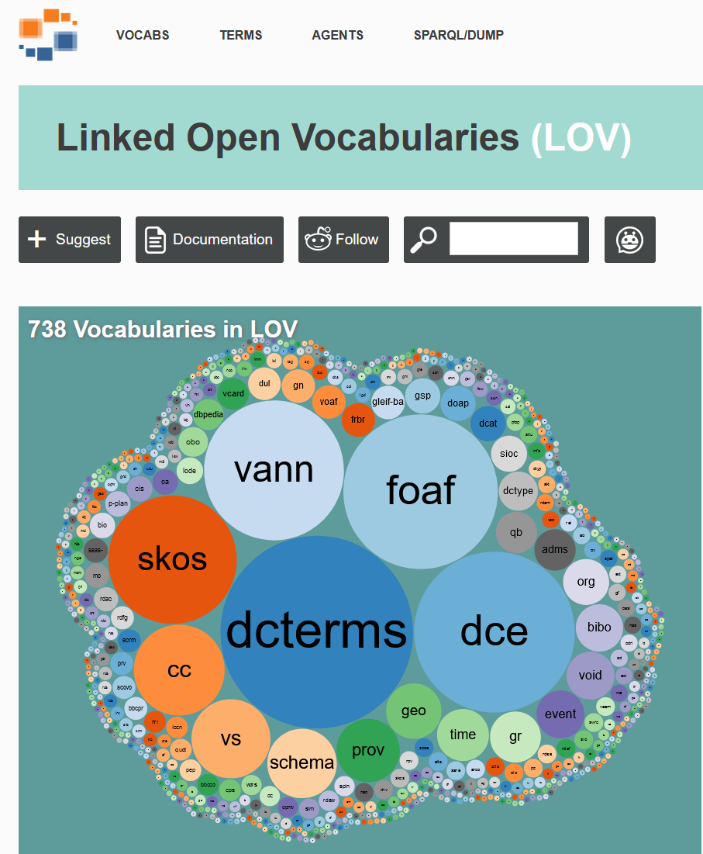
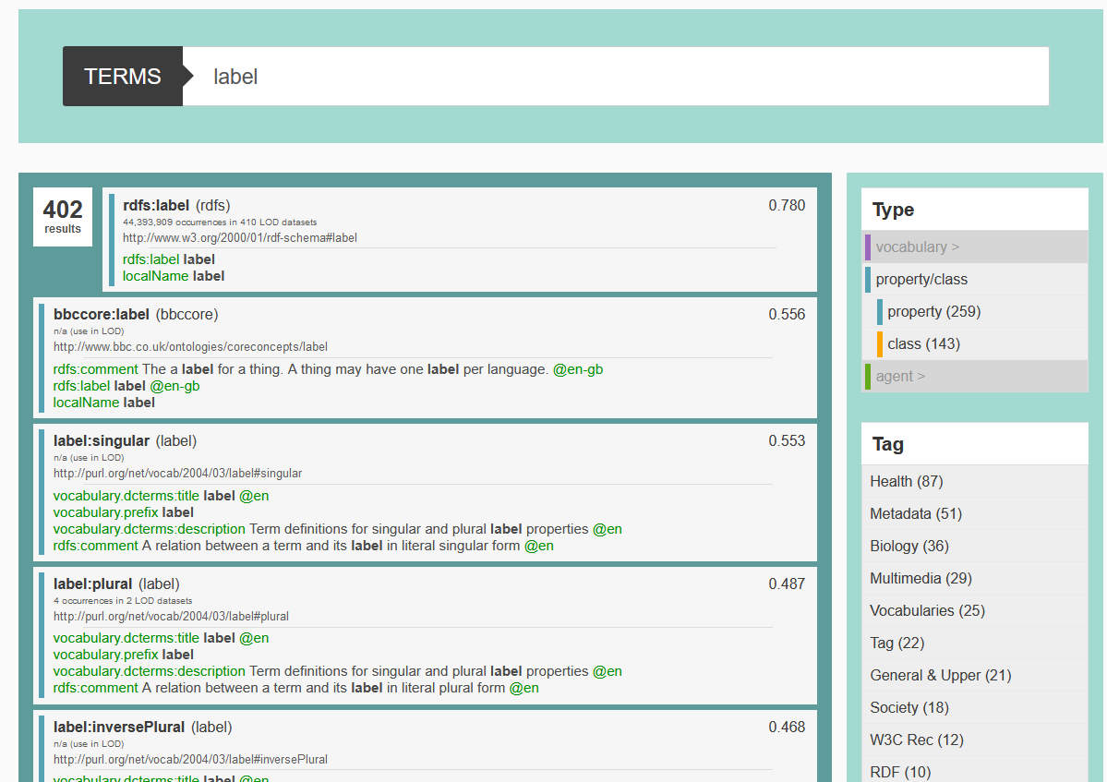
https://lov.linkeddata.es/dataset/lov/
Notes:
⚠️ Not all published vocabularies are well built, be critic when you choose a vocabulary

Slide 32
From natural language to RDF data model to machine readable statements
natural language
RDF is a W3C standard
abstract syntax
(data model)
rdf:type
w3:RDF
w3:standards
serialization
<https://www.w3.org/RDF>
<http://www.w3.org/1999/02/22-rdf-syntax-ns#type>
<https://www.w3.org/standards> .

Slide 33
RDF Syntaxes: N-Triples
rdfs:label
w3:RDF
“Resource Description Framework”@en
N-Triples
<https://www.w3.org/RDF> <http://www.w3.org/2000/01/rdf-schema#label> "Resource Description Framework"@en .
Each line is composed of subject, predicate, object
IRIs are encapsulated by angled brackets < >
Literals by quotes “” and optionally with language tags (@lang) or datatype IRIs (^^IRI)
lines terminated by periods .
ℹ️ Easier to stream or split the data in chunks, but less readable and larger files

Slide 34
RDF Syntaxes: Turtle
rdfs:label
w3:RDF
“Resource Description Framework”@en
Turtle
@prefix rdfs: <http://www.w3.org/2000/01/rdf-schema#>
@prefix w3: <https://www.w3.org/>
w3:RDF rdfs:label "Resource Description Framework"@en .
Each line composed of subject, predicate, object
Prefixes can be defined at the start, and used in a shorthand notation prefix:suffix that expands to valid IRIs
IRIs are encapsulated by angled brackets < >
Literals by quotes “” and optionally with language tags (@lang) or prefixed datatypes (^^xsd:datatype)
lines terminated by periods .
ℹ️ One of the most popular way to write RDF, compact and easy to read

Slide 35
Turtle: Multiple statements about one resource
A resource may have multiple properties with values
Specified by separating the properties with values by semicolons
A property of a resource may contain multiple values
Specified by separating the values by commas:
Turtle
@prefix rdfs: <http://www.w3.org/2000/01/rdf-schema#>
@prefix schema: <https://schema.org/>
@prefix um: <http://maastrichtuniversity.nl/>
um: a schema:CollegeOrUniversity ;
rdfs:label "Maastricht University" ;
schema:department um:FSE, um:FHML .

Slide 36
RDF syntaxes: RDF/XML
rdfs:label
w3:RDF
“Resource Description Framework”@en
<?xml version="1.0"?>
<rdf:RDF
xmlns:rdf="http://www.w3.org/1999/02/22-rdf-syntax-ns#"
xmlns:rdfs="http://www.w3.org/2000/01/rdf-schema#"
<rdf:Description rdf:about="https://www.w3.org/RDF">
<rdfs:label lang="en">Resource Description Framework</rdfs:label>
</rdf:Description>
</rdf:RDF>
RDF/XML
Namespace declarations
Uses the eXtensible Markup Language to represent RDF triples; can define and use namespaces.
A namespace in XML refers to a location on the web where resources are defined.

Slide 37
We can connect triples and a graph emerges where the node IRIs are shared
rdfs:label
“Resource Description Framework”
w3:RDF
dcterms:created
“1999”^^xsd:year
ex:created-by
rdfs:label
“World Wide Web Consortium”@en
w3:W3C
1994-10-01^^xsd:date
ex:established
ex:has-director
TBL

Slide 38
RDF Graphs
An RDF Graph is a labeled, directed multigraph. An RDF Named Graph is identified by an URI. The resources in this graph will share this URI as their common namespace
<graph uri>
predicate
subject
object
N-Quads
predicate
TriG
subject
object
JSON-LD
predicate
subject
object

Slide 39
RDF Graph Syntaxes: N-Quads
N-Quads
<http://maastrichtuniversity.nl>
<http://www.w3.org/2000/01/rdf-schema#label>
"Maastricht University"
<http://example.org/mygraph> .
<http://maastrichtuniversity.nl>
<http://www.w3.org/1999/02/22-rdf-syntax-ns#type>
<http://example.org/University>
<http://example.org/mygraph> .

Slide 40
RDF Graph Syntaxes: TriG
TriG
@prefix rdf: <http://www.w3.org/1999/02/22-rdf-syntax-ns#>
@prefix rdfs: <http://www.w3.org/2000/01/rdf-schema#>
@prefix : <http://example.org/>
:mygraph {
<http://maastrichtuniversity.nl> a :University ;
rdfs:label "Maastricht University" .
}

Slide 41
RDF Graph Syntaxes: JSON-LD
see
https://json-ld.org/playground/
JSON-LD
{
"@context": {
"ex": "http://example.org/",
"rdfs": "http://www.w3.org/2000/01/rdf-schema#"
},
"@id": "ex:mygraph",
"@graph": [
{
"@id": "http://maastrichtuniversity.nl",
"@type": "ex:University",
"rdfs:label": "Maastricht University"
}
]
}

Slide 42
Which RDF syntax does not allow the specification of prefixes?
ⓘ
Click Present with Slido or install our Chrome extension to activate this poll while presenting.
Notes:
📣 This is Slido interaction slide, please don't delete it. ✅ Click on 'Present with Slido' and the poll will launch automatically when you get to this slide.

Slide 43
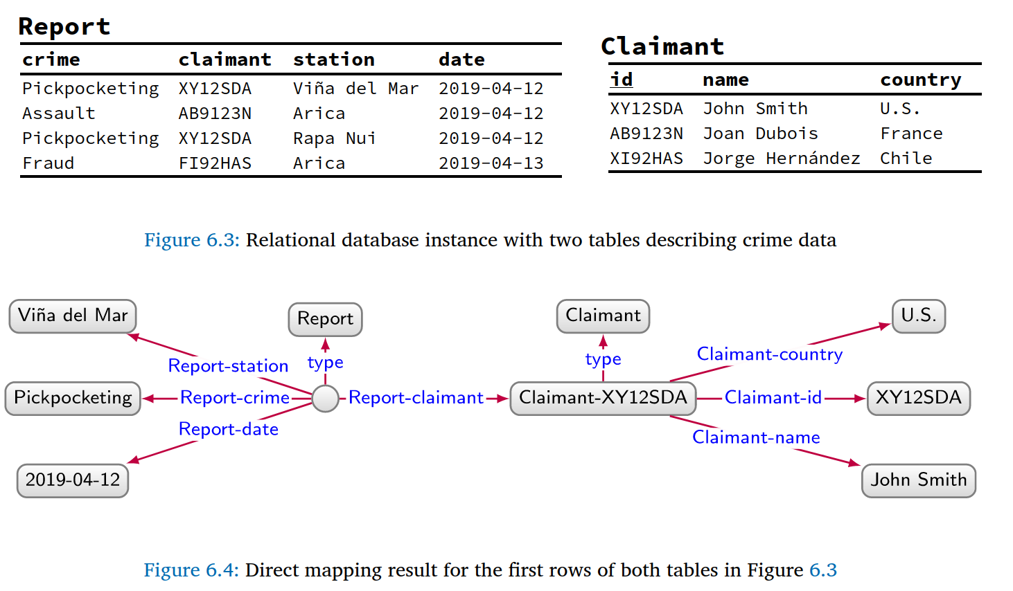
Building a KG from structured data
Source: https://kgbook.org
Notes:
Source: https://kgbook.org

Slide 44
Building a KG from structured data
Programming language and their RDF library. Allow to create URIs and triples, parse and save files in the different RDF formats
Python: RDFLib
PHP: EasyRDF
JavaScript: various libraries listed at rdf.js.org
R: rdflib (cf. introduction article)
Java:
RDF4J: from the Eclipse foundation
Jena: from the Apache Foundation
SANSA stack: for large datasets using parallel processing on Spark, or Flink clusters
Rust: oxigraph 🏗️

Slide 45
Building a KG from structured data
Mapping tools
R2RML for SQL databases
Mapping language in RDF to convert SQL database to RDF
RML and YARRRML for CSV, JSON, XML, SQL
Extension of R2RML to also convert popular data formats, such as CSV, JSON, XML
YARRRML is RML expressed as YAML, instead of RDF, making it easier to read and write for humans
SPARQL-Generate to query structured files directly with SPARQL
The most popular currently is RML/YARRRML, with multiple different engines implemented to perform the mapping execution and generate the KG.

Slide 46
Building a KG from structured data
Common challenges:
Graph Normal Form. fix typos, split multi-values
map enumerations to controlled vocabularies, where possible. otherwise create your own vocabulary and publish it along with your data.
Generate proper and persistent IRIs for your entities (i.e. purl, w3id)
Find the right vocabulary terms and conceptual model to describe your data
Link entities to others concepts/data on the web.

Slide 47
Storing and sharing knowledge
Data can be disseminated by including it in HTML page. For instance adding the JSON-LD describing a recipe in your website. That’s how Google recommend you to communicate them infos about your website.
But all this data can also be put as a whole into a database (aka. triplestore) for querying (with SPARQL)
ℹ️ A project to gather JSON-LD data from web pages: http://webdatacommons.org/structureddata

Slide 48
Linked Data Principles
Use Uniform Resource Identifiers (URIs/URLs) as identifiers for things
Use HTTP URIs, so that people can look up those entities
When someone looks up a URI, provide useful information, using Semantic Web standards
Include links to other URIs, so that they can discover more things
Notes:
You could see the semantic web as a huge database using URLs as resources identifiers
URI are basically the same thing as URL
Uniform Resource Identifier / Uniform Resource Locators
There is also the concept of IRI now, which supports unicode characters such as mandarin or emojis:
International Resource Identifier

Slide 49
Summary

